Slide 1


Slide 2

DATA
CONNECTORS
but why

Slide 3



WHY WE NEED DATA CONNECTORS
More Perspective
- Helps real time vision
Analysis
- Proper vision of data
Securing future
Securing datasets
Build applications
APIs
- Predictive Analysis
More real time data
Help industry
Help Humanity
Cloud Applications
Auto functionality
- Integration with data world
- Get automation

Slide 4





HOW CAN IT HELP?
Access data
Calculation
Mashupdata
Get data
Through applications
Deploy measures anytime anywhere
Data minning
Get your own data from webapi

Slide 5


WHAT WILL IT HELP
REST API
BRANDING
Service Offers
IMPROVE USEABILITY
Authentication
Direct Query
ODBC driver
Create friendly view
Provide branding
- SAAS
PowerBI content pack
-Enable direct queries
- ODBC driver
-support
- Limited view
Create new data sources
Extend an existing source
- Helps it amazingly!
- Awesome

Slide 6
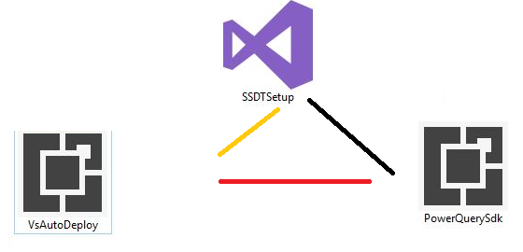
So, what are the components we need to work with dataconnectors in PowerBI
- M function through advanced editor.
- Enable custom data connectors and also create a folder.
- Visual Studio 2017.
- PowerQuery SDK.
- VS Auto Deploy

Slide 7
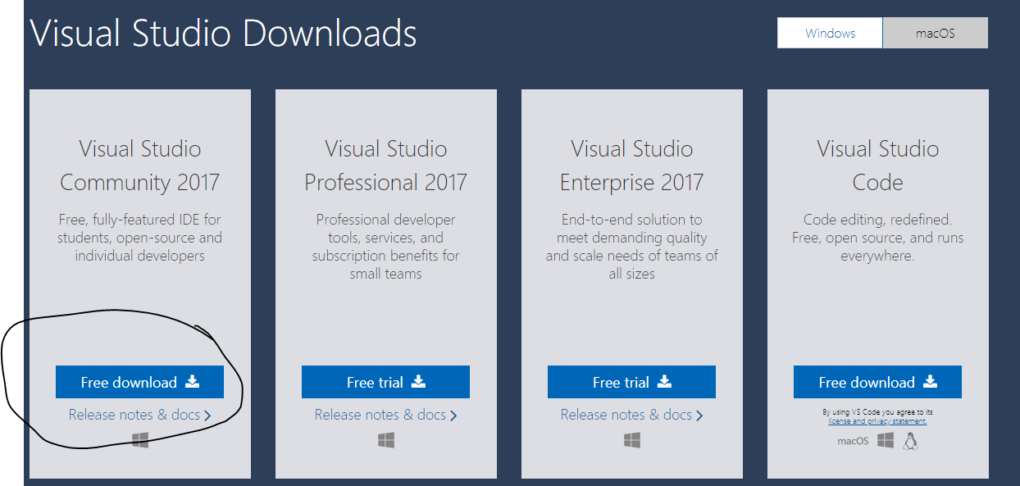
https://visualstudio.microsoft.com/downloads/?utm_medium=microsoft&utm_source=docs.microsoft.com&utm_campaign=button+cta&utm_content=download+vs2017

Slide 8
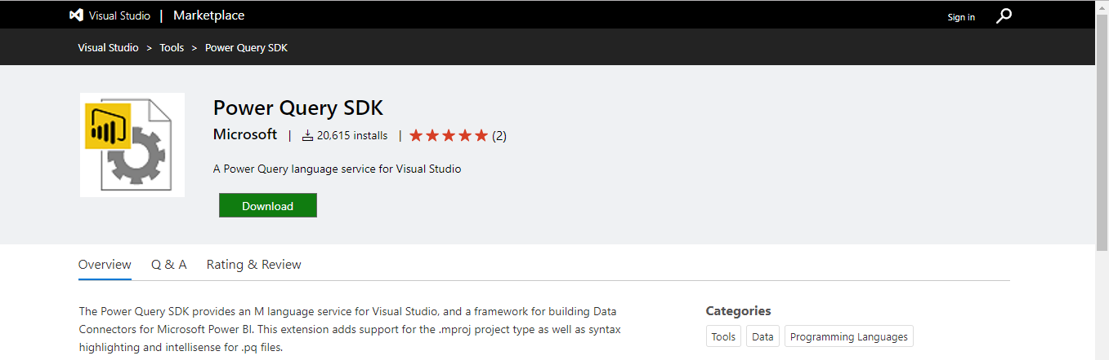
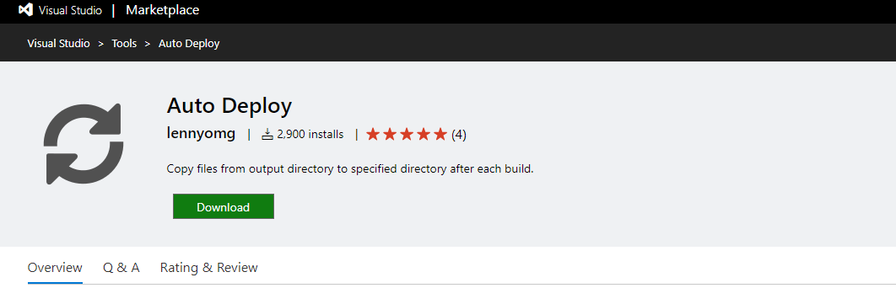
https://marketplace.visualstudio.com/items?itemName=Dakahn.PowerQuerySDK
https://marketplace.visualstudio.com/items?itemName=lennyomg.AutoDeploy

Slide 10
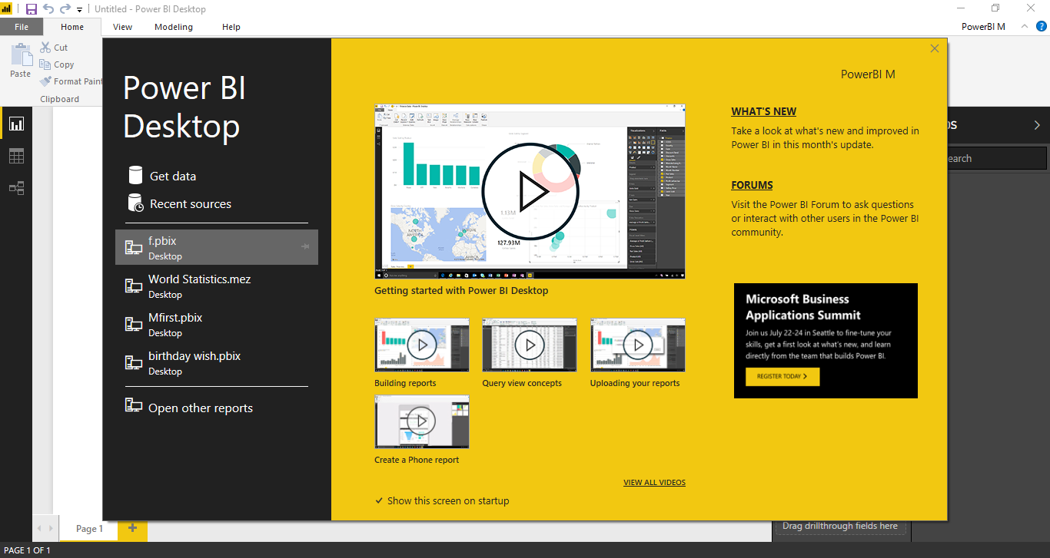

Slide 11
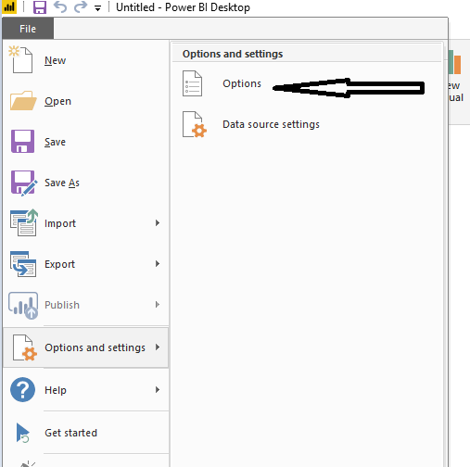
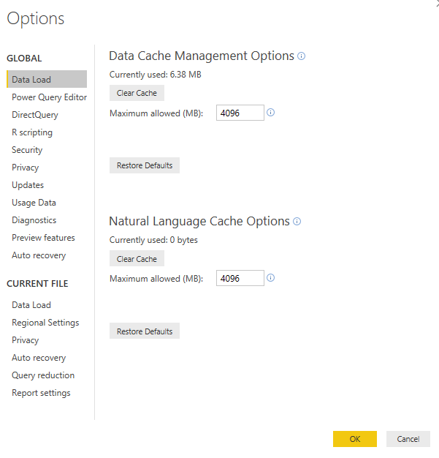

Slide 12
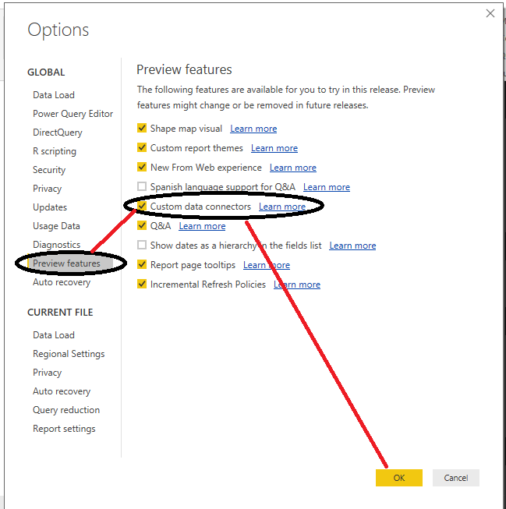
It will enable the custom data connector but the problem hasn’t solved yet.

Slide 13
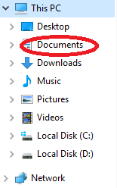
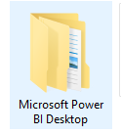
Go to documents and create the folder like this
And then take the path while in deploy

Slide 14
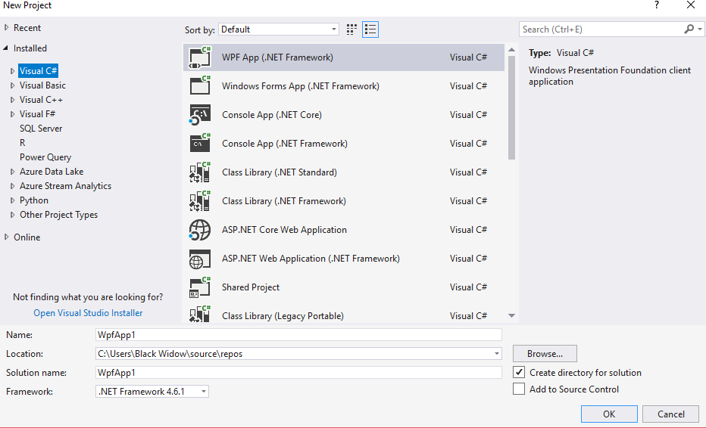
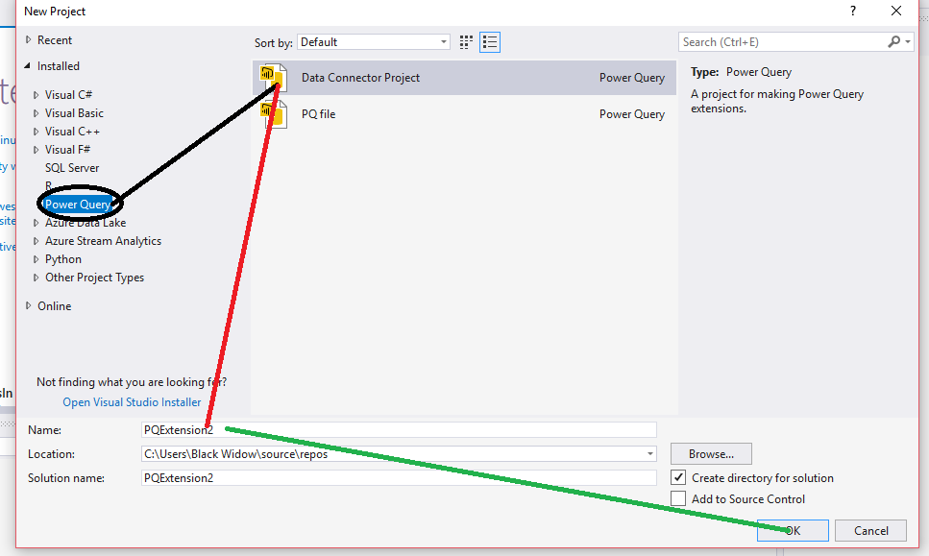

Slide 15
“World_new.pq” file
Where all of the magic happens.
All of your functions and logic are here,
and the function(s) annotated with your Publish attribute are going to show up in your “Get Data” list.
“World_new.query.pq” file
Your test file.
When you debug in Visual Studio, this is going to be the entry point for testing functions from your .pq file.
Connector icons
A list of eight PNG files that represent the various icons for your connector.
These are created automatically with the Power BI logo, and you can swap them out with your own icons if you want.

Slide 16
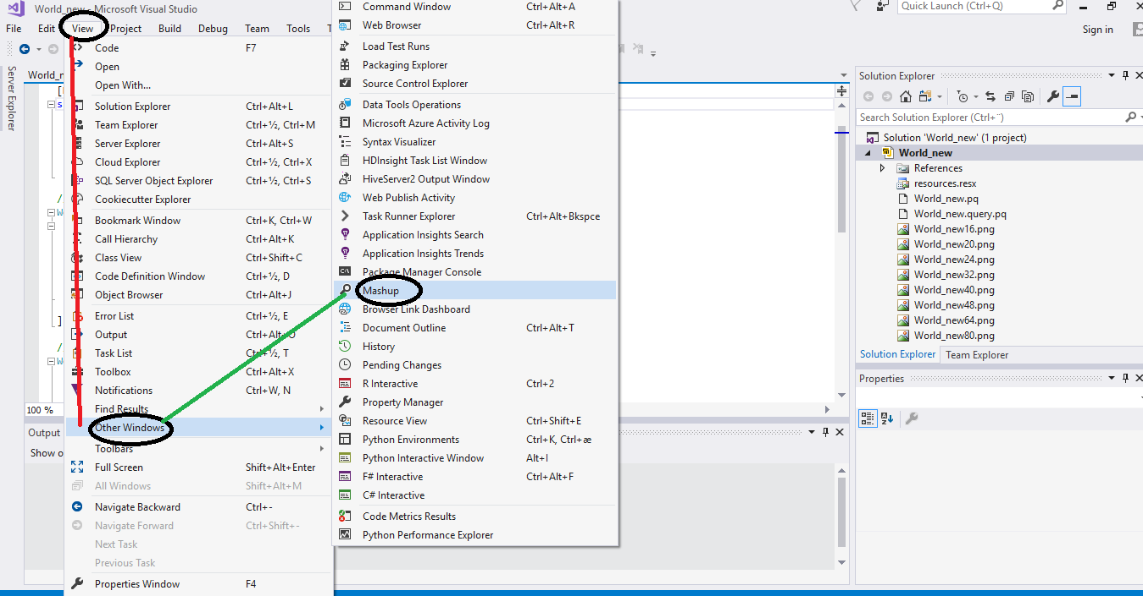

Slide 17
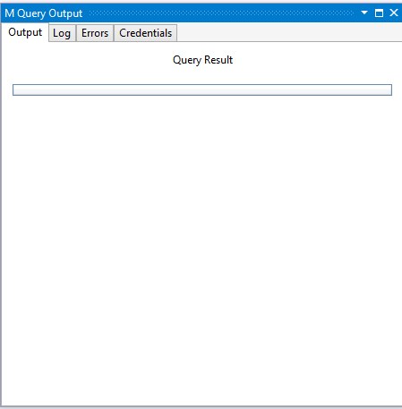
Type a quick line of M code into the “.query.pq” file, and hit F5 to see the results in your “M Query Output” Window.

Slide 18
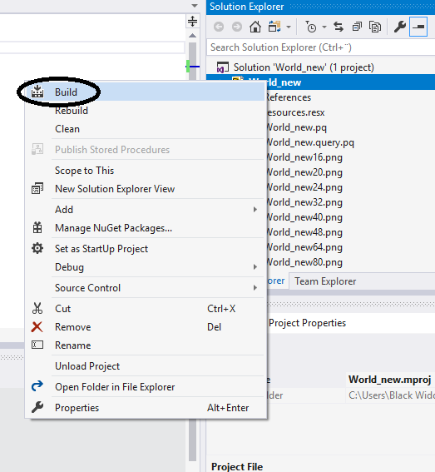


Slide 19
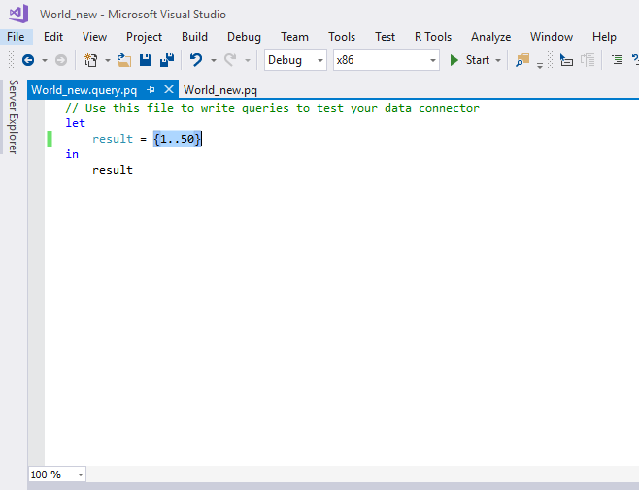
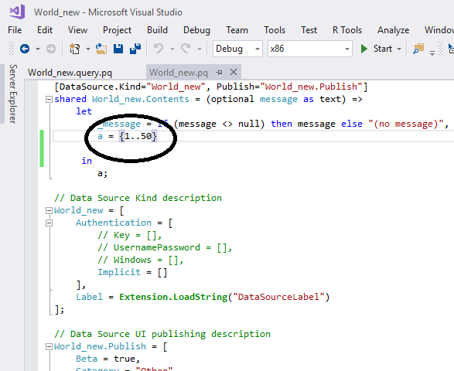

Slide 20
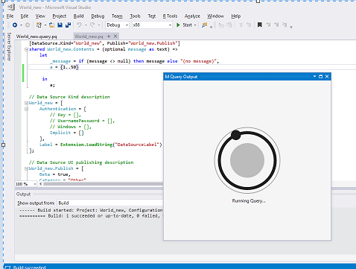
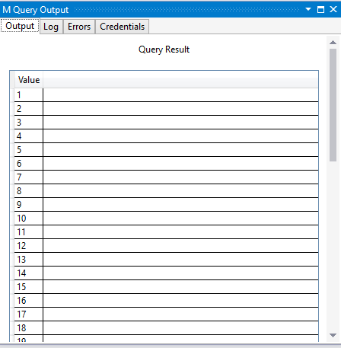

Slide 21
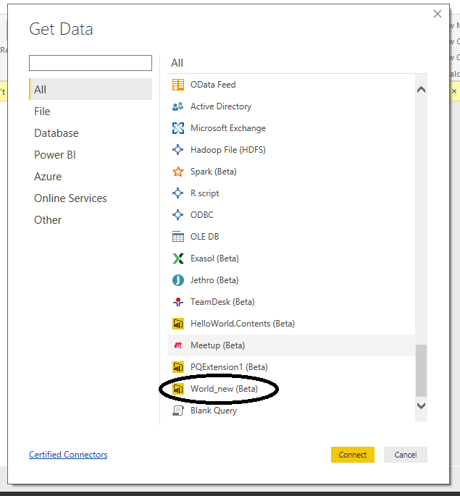
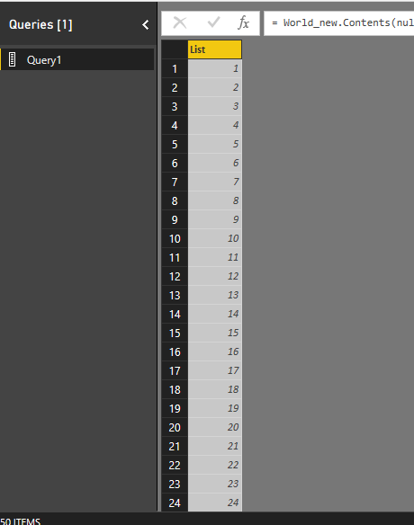

Slide 22
20%
GRIDS
LINES
SIZE
SHAPES
CONSISTENCY
ALIGNMENT
SPACING
COLOR
SIMPLICITY
BALANCE
BACKGROUND
CONTRAST

Slide 23
MEASURES
RELATIONSHIPS
DAX
DATA SOURCES
EDIT QUERIES
APPEND
TRANSPOSE
M
DRILL DOWN
UNPIVOT
COMBINE BINARIES
FORMULAS
MULTIDIMENSIONAL TABLES
HIERARCHY
SPLIT COLUMNS
MODELING
SORT BY
AGGREGATE
MERGE
EXTRACT
FILTERS
PIVOT
REPLACE
REMOVE DUPLICATES
EXPAND
SUMMARIZATION

Slide 24
WORKING,
CLEANING
ENHANCING
80%
AND
THE
DATA

Slide 25




Resources
Get Power BI (Free) http://tinyurl.com/hj5hdg6
Power BI Jump Start http://bit.ly/1ktON16
Power BI Getting Started http://bit.ly/1FF88KA
Power BI Team Blog http://bit.ly/1vwbTLG
Power BI Channel 9 http://bit.ly/1a9Q0gv
Power BI https://powerbi.microsoft.com

Slide 26
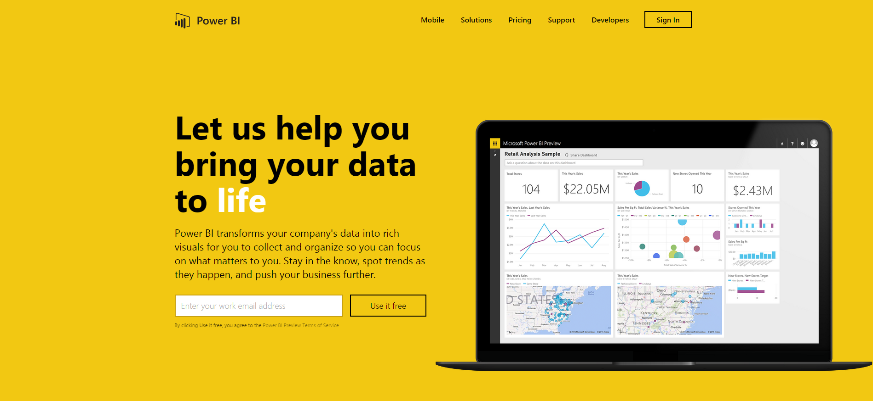
Thankyou for Coming to PowerBI
Sign up for a free Preview account
Take the Power BI Tour
Notes:
Thanks for taking the time to walk through the main capabilities of Power BI.
If you’re ready to start exploring what Power BI can do for you and your organization, please visit powerbi.com.

